Slide 1

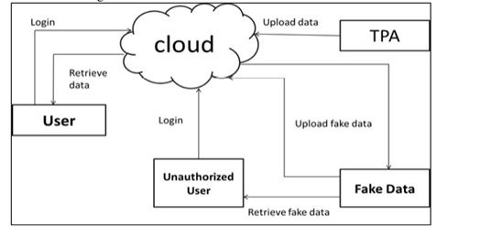
DATA LEAKAGE AND SECURITY ON CLOUD COMPUTING
DANUSU B, HARI PRASATH S, JEGADEESWARAN R, MOHANKUMAR S, Mr. R.RAJINIGANTH
Introduction
Results
Data loss occurs when data is intentionally or unintentionally removed physically or logically from an organization. Data loss has become the largest problem in organizations today, and organizations are responsible for addressing this problem. A data breach is an incident where the confidentiality of information is compromised. This represents the unauthorized transmission of data to external recipients within the organization. Leaked data can be private in nature and can be considered confidential, and data loss is data loss due to deletion, system failure, etc. The greatest fear facing organizations today data loss/leakage.
As a result of using this implement a variety of data distribution strategies that can improve the distributor’s chances of identifying a leaker. We have shown that distributing objects judiciously can make a significant difference in identifying guilty agents, especially in cases where there is large overlap in the data that agents must receive..
Motivation
The main motivation behind this project there was the impact of a data breach is enormous. Data breaches at companies like precisely exposed 340 million customer records. The incident also resulted in financial loss to, reputational damage, loss of customer trust, and compliance issues with the firm.
Scope of the Project
The scope of this project included :
More Security for data/content that is accessed by the users.
Improves authentication technique and prevent the leakage of the data.
Data is completely secured.
Login page
Methodology
Data leak detection, the proposed system shown in Figure is to detect when the confidential data of the distributor is lost by the agent, and possibly identify the agent with the data leak.
Perturbation is a very useful technique to make data modified and "less sensitive" before being passed to agent.
To increase the security of user data, the model has an encrypted algorithm that ensures secure data transfer between the user and the Third-Party Application(TPA)
It includes the cloud as well as algorithms that distribute objects between agents in a way that improves the likelihood of detecting leaks. When adding misinformation objects to a distributed set, misinformation is provided if the data is provided to another third party
SHA ALGORITHM:Secure SHA algorithm provides a hash function when downloading data by referring to a third-party agent and provides to the real cloud. This security feature has been added to improve the security of sensitive data transmission over the Internet. The SHA algorithm is used because it uses message digests to ensure data integrity and confidentiality. This approach uses Secure Hash Algorithm 2 (SHA2), a subset of the Keccak cryptography primitive family, to ensure data security.
User Activation in Admin panel
Leak message detection
Conclusion
In a perfect world, there would be no need to hand over sensitive data to agents that may unknowingly or maliciously leak it. And even if we had to hand over sensitive data, in a perfect world, we could watermark each object so that we could trace its origins with absolute certainty. When comparing to related operations, the other methods focus more on data leaks occurring at the application level. Going forward, we would like to expand our investigation by discovering potential data breaches in other cloud components such as block storage, API requests, and telemetry.
System Architecture
References
[1] Chaudhary, H., Chaudhary, H., & Sharma, A. K. (2022). Optimized Genetic Algorithm and Extended Diffie Hellman as an Effectual Approach for DOS-Attack Detection in Cloud. International Journal of Software Engineering and Computer Systems, 8(1), 69-78.
[2] Rishabh Singh, V Gokul Rajan, Galgotias University, U.P. India,May 2022, ‘Data Leakage and Security on Cloud Computing’, vol. 127, no. 1-2.

